Slide 1

PDPM Indian Institute of Information Technology Design and Manufacturing, Jabalpur MEPR101
COCAP
( CYCLE OPERATED CYCLE AIR PUMP )
Group No.23
Amanat Mishra(2017034)
Kuhu Pyasi(2017327)
Kanishk Singh Thakur(2017323)
Kaushal Kishor Sharma(2017324)
Shivam Dixit(2017348)

Slide 2
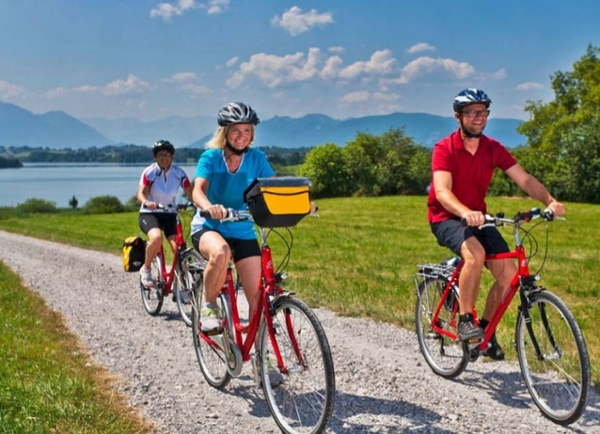
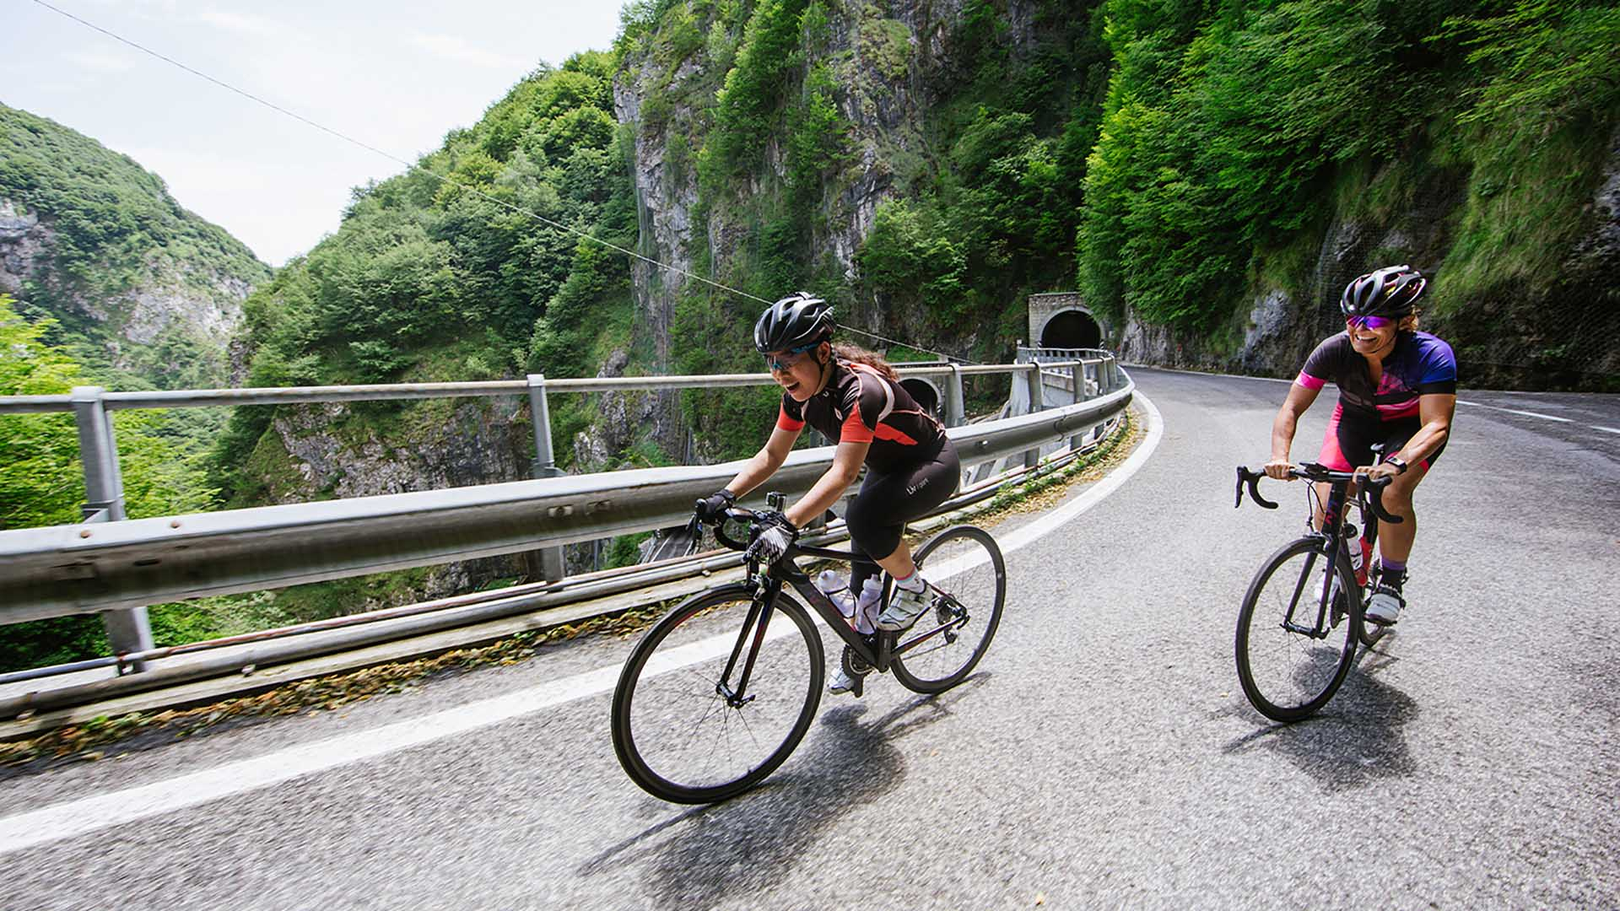
INTRODUCTION
COCAP
CYCLE OPERATED CYCLE AIR PUMP
Cycling is the most energy efficient urban transport mode with a high potential to reduce energy consumption
As the world is returning back to cycles, we aim to solve the problem of deflated air tyres with COCAP
COCAP (cycle operated cycle air pump) is a portable cycle operated air pump that will inflate the tyres on reversing the direction of paddle movement

Slide 3
OBJECTIVE AND PURPOSE
Whether due to health benefits ,environmental factors or financial reasons more people are becoming bicycle commuters
It is a solution to everyday problem of driving around the city with deflated tyres in search of air pump . It is useful to every bicycle commuter
In Rural areas where people travel large distance for their work and earnings which mostly uses cycle as a mean of transport so it is a cheap and durable solution for their common problem of deflated tyres.
Can be used fo other purposes too.

Slide 4
METHODOLOGY
As per the requirement concept had been framed for implementation which is feasible on paper
Market has been surveyed for the required items and materials
Items which are not readily available have been discussed with the local manufacturer
Gear driven reciprocating pump is to be procured .
Matching pair of gear can be designed and manufactured by CNC MACHINE that has been discussed .
Proper fitment is to be designed so that pump can be attached or detached from driving gear .
For the fitment and clamping facility , discuss with the fabricators .

Slide 5
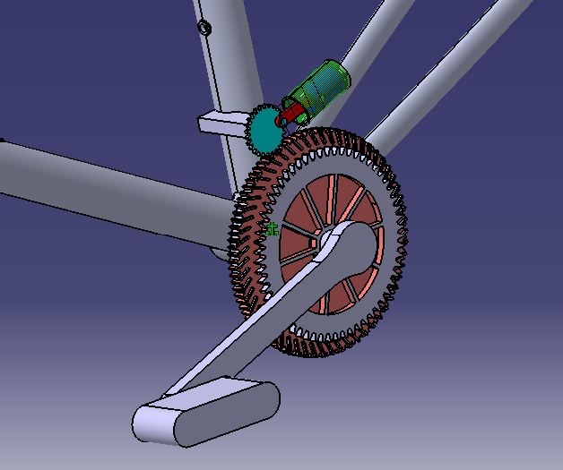
WORKING

Slide 6
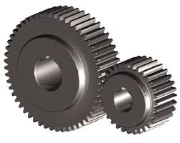
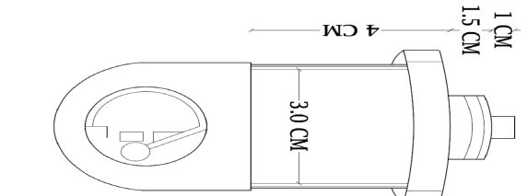
MATERIAL REQUIRED
S.NO | COMPONENTS | SPECIFICATION
1. | GEAR- 1. | Diameter 15cm and width 0.8cm
2. | GEAR 2. | Diameter 3.5cm And width 0.6cm
3. | RECIPROCATING PUMP
4. 5. | DISCHARGE PIPE NOZZLE | Length 1.5m(aprrox) diameter 5mm.

Slide 7
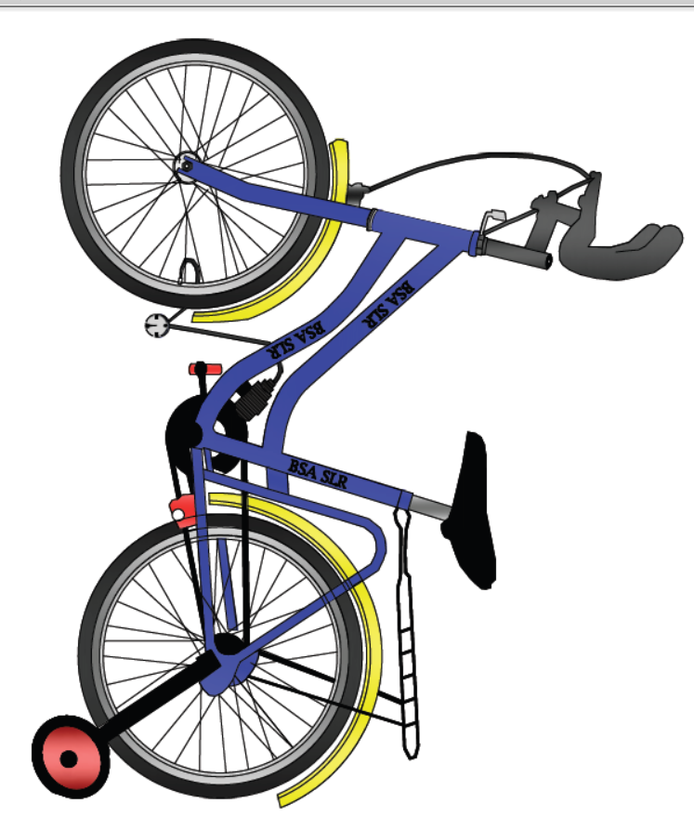
DESIGN OF MODEL

Slide 8
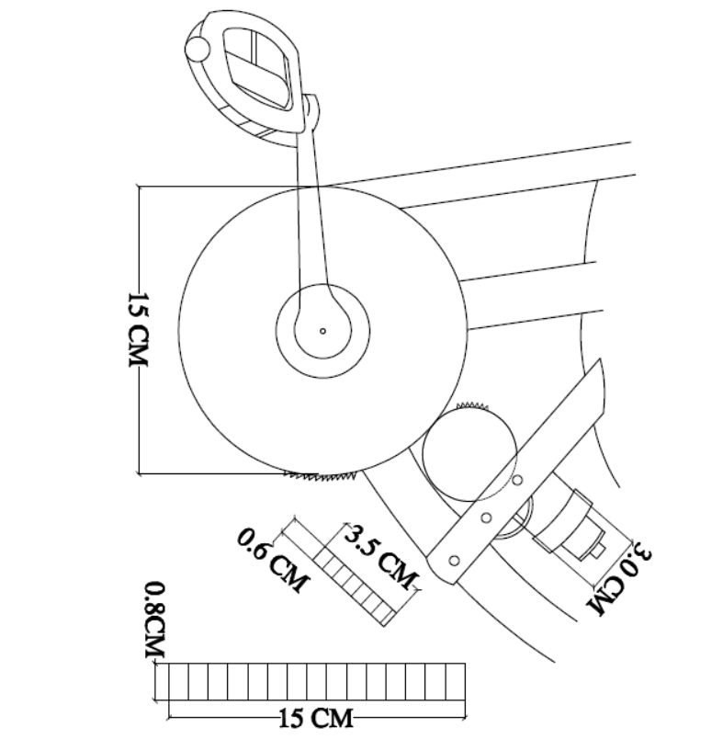

MODEL SKETCH
ROUGH SKETCH OF PROPOSED MODEL
RECIPROCATING PUMP

Slide 9
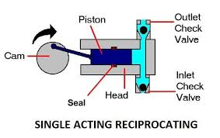
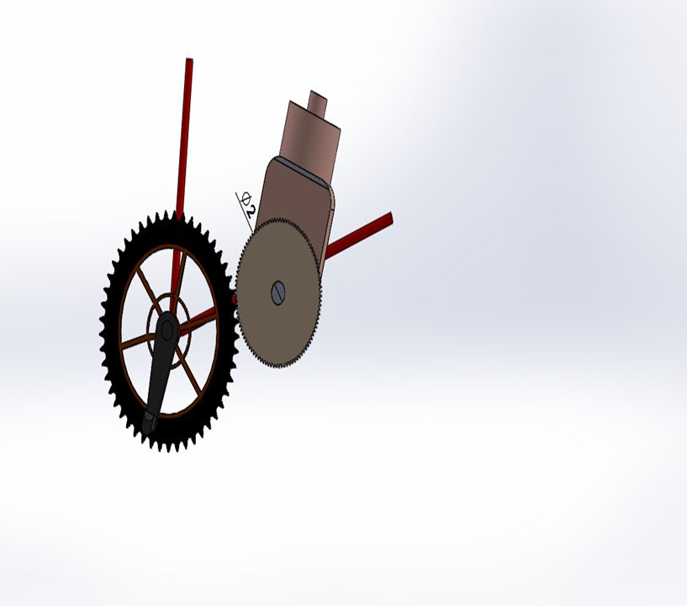
RECIPROCATING MACHINE

Slide 10
PROGRESS FROM PREVIOUS PRESENTATION
Specification of model has been analyzed in details
Modeling of project has been done in AUTOCAD.
CATIA SOTWARE has been used to design a video graphic representation
Availability of components has been checked upon to determine the feasibility of project.

Slide 11
PROJECT PLAN
DECEMBER - Further research regarding technicalities of our project
Will work on gathering required materials
19th JANUARY – Report submission(PS -1)
9th FEBRUARY – Progress submission - evaluation
13th FEBRUARY – Report submission (PS-2)
Till 20th JULY- Making of pump
20-25TH JULY – Final submission of our project.

Slide 12
ESTIMATED BUDGET
S. NO. | NAME | QUANTITY | DIMENSIONS | PRICE | Reference
1. | SPUR GEAR(BIG) | 1 | Diameter: 15cm | 250(approx) | India mart
 | SPUR GEAR (SMALL) | 1 | Diameter: 3.5cm Width: 0.6cm | 200(approx.) | India mart
2. | METAL SHEET | 1 |  | 100(approx.) | Science emporium
3. | RUBBER PIPE | 1 | Length: 1.5metre | 50
4. 5 6. 7. | NOZZLE AND SCREWS RECIPROCATING PUMP BICYCLE OTHER CHARGES | 1 1 1 |  | 70 1700 1800 200 | Science emporium
 | TOTAL | 7 |  | 4370

Slide 13
THANK YOU

